Slide 1
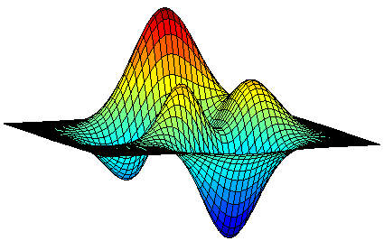

Deterministic and Combinatorial Algorithms for Submodular Maximization
Moran Feldman
The Open University of Israel

Slide 2
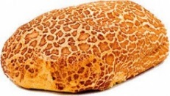

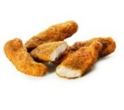


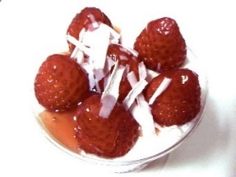
Motivation: Adding Dessert
Meal 1 | Meal 2
Alternative Definition
f(A) + f(B) ≥ f(A ∪ B) + f(A ∩ B)
∀ A, B ⊆ N.
Ground set N of elements (dishes).
Valuation function f : 2^{N}  ℝ (a value for each meal).
Submodularity: f(A + u) – f(A) ≥ f(B + u) – f(B)
∀ A ⊆ B ⊆ N, u ∉ B.

Slide 3


Another Example
7
11
0
6
8
0
5
10
5
N
4
-8

Slide 4
Submodular Optimization
Submodular functions can be found in:
Combinatorics
Machine Learning
Image Processing
Algorithmic Game Theory
Motivates the optimization of submodular functions subject to various constraints.
  Generalizes classical problems (two examples soon).
  Many practical applications.
In this talk, we only consider submodular maximization.

Slide 5

Example 1: Max DiCut
Instance: a directed graph G = (V, E) with capacities c_{e} ≥ 0 on the arcs.
Objective: find a cut (S, V \ S) with a maximum capacity.
Instance: a directed graph G = (V, E) with capacities c_{e} ≥ 0 on the arcs.
Objective: find a cut (S, V \ S) with a maximum capacity. In other words, find a set S ⊆ V maximizing the function
Observation
f(S) is a non-negative submodular function.
Special case of unconstrained maximization of such functions.
f(S) = 4

Slide 6

Example 2: Max k-Cover
Instance: elements E = {e₁, e₂, …, e_{n}} and sets s₁, s₂, …, s_{m} ⊆ E.
Objective: find k sets covering as many different elements as possible. In other words, find a collection S ⊆ {s₁, s₂, …, s_{m}} of size at most k maximizing
Instance: elements E = {e₁, e₂, …, e_{n}} and sets s₁, s₂, …, s_{m} ⊆ E.
Objective: find k sets covering as many different elements as possible.
A set function f: 2^{N}  ℝ is monotone if f(A) ≤ f(B) for every A ⊆ B ⊆ N.
Observation
f(S) is a non-negative monotone submodular function.
Special case of maximization of such functions subject to a cardinality constraint.
s₂
s₃
s₁
s₄
s₅

Slide 7
Continuous Relaxations
Sumodular maximization problems are discrete.
Nevertheless, many state of the art algorithms for it make use of a continuous relaxation (the multilinear relaxation).
The objective is replaced with its multilinear extension.
Defined as the expected value of the original objective over some distribution.
Similar to the standard technique of solving an LP relaxation and rounding.
The Multilinear Relaxation
max F(x)
s.t. x ∈ P ∩ [0, 1]^{N}
The constraints remain linear.

Slide 8

Issues with this Approach
(Approximately) solving the multilinear relaxation requires us to repeatedly evaluate the multilinear extension.
Each evaluation is done by randomly sampling from the distribution used to define this extension.
Tends to be quite slow
Inherently randomized (often undesirable)
We want Combinatorial algorithms
We want Deterministic algorithms

Slide 9

Additional Randomized Algorithms
For simple enough constraints, good (and simple) combinatorial algorithms are known.
  For example, a cardinality constraint.
Tend to be deterministic for monotone objectives.
Usually randomized for non-monotone objectives.
Even for simple constraints, if the objective function is non-monotone than finding good deterministic algorithms is (partially) open.

Slide 10
Objectives Summary
Summary of what we are looking for
For simple constraints with non-monotone objectives
For more involved constraints with monotone objectives
Partially answered
First result we will see
Recent results make first baby steps
Second result we will see
We have good randomized combinatorial algorithms
We have good continuous algorithms
We want good deterministic algorithms
We want good combinatorial and/or deterministic algorithms

Slide 11
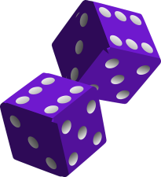
Derandomizing Already
Combinatorial Algorithms

Slide 12

The Profile of the Algorithms
Works in iterations.
In every iteration:
  Starts with some state S.
  Randomly switches to a new state from a set N(S).
  For every S’ ∈ N(S), let p(S, S’) be the probability that the algorithm switches from S to S’.
The analysis works whenever the probabilities p(S, S’) obey k linear constraints that might depend on S, where k is polynomial:

Slide 13
Derandomization – Naïve Attempt
Idea
Explicitly store the distribution over the current state of the algorithm.
(S₀, 1)
The number of states can increase exponentially with the iterations.
The initial state
(S₁, p)
(S₂, 1 - p)
(S₃, q₁)
(S₆, q₄)
(S₄, q₂)
(S₅, q₃)

Slide 14

Strategy [Buchbinder and F 16]
S
p(S, S₁)
p(S, S₂)
p(S, S₃)
S₁
S₂
S₃
The state S_{i} gets to the distribution of the next iteration only if p(S, S_{i}) > 0.
We want probabilities that:
  obey the constraints.
  are mostly zeros.

Slide 15

Expectation to the Rescue
Some Justifications
We now require the analysis to work only for the expected output set.
Can often follow from the linearity of the expectation.
The analysis of the algorithm works when:
(D is the current distribution).
Often it is enough for the constraints to hold in expectation over D.
𝔼
𝔼

Slide 16
Finding a good solution
Has a solution (the probabilities used by the original algorithm).
Bounded.
𝔼
𝔼
The size of the distribution can increase by at most k at every iteration.
A basic feasible solution contains at most one non-zero variable for every constraint:
One non-zero variable for every current state.
k additional non-zero variables.

Slide 17

So the algorithm is…
Deterministic Algorithm
Explicitly stores a distribution over states.
In every iteration:
  Uses the previous LP to calculate the probabilities to move from one state to another.
  Calculates the distribution for the next iteration based on these probabilities.
Sometimes the LP can be replaced by a combinatorial algorithm, so the resulting algorithm remains combinatorial.
Performance
The analysis of the original (randomized) algorithm still works.
The size of the distribution grows linearly in k – polynomial time algorithm.
✓

Slide 18
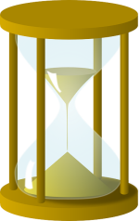
History and Results
Unconstrained Submodular Maximization
Best randomized algorithm: 0.5 [Buchbinder et al. 12]
Inapproximability: 0.5 [Feige et al. 07]
Previously best det. algorithm: 0.4 [Dobzinski and Mor 15]
New deterministic algorithm: 0.5 [Buchbinder and F 16]
Maximization subject to a Cardinality Constraint
Best randomized algorithm: 0.385 [Buchbinder and F 16]
Inapproximability: 0.491 [Oveis Gharan and Vondrak 11]
Previously best det. algorithm: 0.25 [Lee et al. 10]
New det. algorithm: 0.367 (e⁻¹) [Buchbinder and F 16]

Slide 19
Combinatorial and Deterministic Algorithms for Involved Constraints

Slide 20

Known Results (Baby Steps)
Local search techniques are the state of the art for some classes of constraints (due to poor rounding options):
Intersection of k matroids [Lee et al. 10]
k-exchange systems [F, Naor, Schwartz and Ward 11]
Intersection of k matroids + a knapsack [Sarpatwar et al. 17]
Maximizing a monotone submodular function subject to a constant number of packing and covering constraints:
Optimal (1 – 1/e)-approximation through the multilinear relaxation. [Kulik et al. 16, Mizrachi et al. 18]
Constant deterministic approximation (at most 1/e) for special cases. [Mizrachi et al. 18]

Slide 21
Known Results (cont.)
Maximizing a monotone submodular function subject to a matroid constraint.
Optimal (1 - 1/e)-approximation through the multilinear relaxation. [Calinescu et al. 11]
Well known ½-approximation by the (deterministic) greedy algorithm. [Nemhauser and Wolsey 78]
Can be understood as an online algorithm
Applying greedy in a random order yields:
0.505-approximation for submodular welfare. [Korula et al. 15]
0.509-approximation for partition matroids [Buchbinder et al. 18].
Recent result [Buchbinder et al. 18]
0.5008-approximation using a deterministic combinatorial algorithm.

Slide 22
Analysis Intuition
Greedy Algorithm
Scan the right vertices in some order (let’s say from top to bottom) and connect every vertex to a free neighbor (if available).
Performance
Achieves ½-approximation.
Worst case performance only when the free neighbor is below the considered vertex.

Slide 23
Analysis Intuition (cont.)
How the worst case looks like?
Unlikely to be matched
Contradiction
(Relatively) large matching
(Relatively) large matching
Highly likely to be matched
Unlikely to be matched

Slide 24

Open Problems
Improving the approximation ratios of deterministic and combinatorial algorithms for involved constraints.
Making the existing deterministic algorithms for simple constraints faster.
Proving a separation between the abilities of randomized and deterministic algorithms.

Slide 25
Questions
?

